Slide 1
CHAPTER 3- Memory Management
What is a memory?
Memory is a large array of words or bytes, each with its own address in computer system.
In computing, memory is a device or system that is used to store information for immediate use in a computer or related digital electronic devices.
The term memory is often synonymous with the term primary storage or main memory
The program must be brought into memory and placed within a process for it to be executed depending on the memory management in use.

Slide 2
Memory management
Memory management is a form of resource management applied to computer memory.
Memory management is the functionality of an operating system which handles or manages primary memory and moves processes back and forth between main memory and disk during execution.
Memory management keeps track of each and every memory location, regardless of either it is allocated to some process or it is free.
It checks how much memory is to be allocated to processes. It decides which process will get memory at what time. It tracks whenever some memory gets freed or unallocated and correspondingly it updates the status.
The essential requirement of memory management is to provide ways to dynamically allocate portions of memory to programs at their request, and free it for reuse when no longer needed.
It checks how much memory is to be allocated to processes and decides which process will get memory at what time.
Memory management provides protection by using two registers, a base register and a limit register. A pair of registers define the logical address space.

Slide 3
Cont…
CPU must check every memory access generated in user mode to be sure it is between base and limit for that user.
The base register holds the smallest legal physical memory address and the limit register specifies the size of the range.
Physical address space = Logical address space + relocation register value.
Relocation register contains value of smallest physical address; limit register contains range of logical addresses - each logical address must be less than the limit register.

Slide 4
Base and Limit Registers

Slide 5
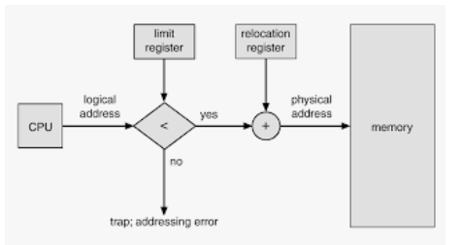
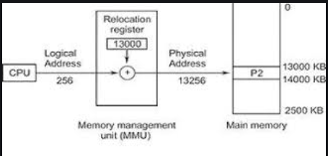
Hardware Address Protection

Slide 6
Logical versus Physical Address Space
An address generated by the CPU is a logical address whereas address actually available on memory unit is a physical address OR Physical address – address seen by the memory unit.
Logical address is also known a Virtual address which are independent of location in physical memory data lives.
The set of all physical addresses corresponding to these logical addresses is referred to as a physical address space.
The set of all logical addresses generated by a program is referred to as a logical address space.
Logical/virtual addresses are translated by hardware into physical addresses called MMU.

Slide 7
Address Binding
The Address Binding refers to the mapping of computer instructions and data to physical memory locations.
Both logical and physical addresses are used in computer memory. It assigns a physical memory region to a logical pointer by mapping a physical address to a logical address.
It is a part of the computer memory management and is performed by the operating system on the behalf of applications that need access to the memory.

Slide 8
Address Binding can be divided into three types:
Compile time address binding
Load time address binding.
Execution time address binding

Slide 9
Compile time address binding
Compile time is when your code is being processed by a compiler. In this context, it's talking about a compiler that is transforming your code into an executable binary.
Compile time address binding allocates a space in the memory to the machine code of the computer when the program is compiled.
In other words, if the compiler is responsible for address binding, then it is known as compiler time address binding. The compiler interacts with the OS to perform the address binding.
If the program location is fixed and known at compile time where the process will reside in memory is called compile time binding.
It is done before loading the program in the computer memory. (Static).
physical addresses (compile-time binding) if the location in memory of the process can be known in advance (non-multi-programmed systems).

Slide 10
Load time address binding
Load time is when the Operating System is reading an executable from long term storage (typically a hard drive) and loading it into short term memory (RAM) from which it can be executed.
So, Load time address binding is the translation of the logical addresses to physical addresses at the time of loading.
If it is not known at compile time where the process will reside in memory then, the relocating loader contains the base address in the main memory from where the allocation would begin.
I.e. Once the loader puts the obj into memory it replaces relocatable addresses with physical addresses (if there are any) and the program can be finally executed.
So when the time for loading a process into the main memory comes, all logical addresses are added to the base address by the relocating loader to generate the physical addresses.
In this cases the binding is static: once loaded, the process can't be moved from one segment of memory to another.
Done by loader which is a vital component of an operating system that is accountable for loading programs and libraries to memory.

Slide 11
Execution time address binding
Execution time address binding is done at the time of program execution.
The address binding will be postponed even after loading the program into memory.
In order to manage the memory in an efficient way, the system should be able to move a process from a location of the memory to another.
This means that the process physical addresses can change at run-time.
Does this mean that, in execution-time binding, the obj file contains virtual addresses ([0, max]), which are converted time by time by the system into physical ones. Dynamic
The program will keep on changing the locations in the memory till the time of program execution. Done by the processor
It is the modern and used in multi-programmed systems.
Additional memory may be allocated or deallocated at this time. Why?

Slide 12
Dynamic vs Static Loading.
In dynamic loading, a routine of a program is not loaded until it is called by the program.
The main program is loaded into memory and is executed and Other routines methods or modules are loaded on request.
Dynamic loading makes better memory space utilization and unused routines are never loaded.
Loading the entire program into the main memory before start of the program execution is called as Static loading.

Slide 13
Dynamic Linking vs Static linking
Here Linking is the process of collecting and combining various modules of code and data into a executable file that can be loaded into memory and executed.
A dynamically linked executable will be smaller because it places calls at runtime to shared code libraries.
Static linking is that static linking copies all library modules used in the program into the final executable file at the final step of the compilation.
In dynamic linking only one copy of shared library is kept in memory. This significantly reduces the size of executable programs, thereby saving memory and disk space.
Static linking produces a larger executable file than dynamic linking because it has to compile all of the library code directly into the executable.
In static linking, libraries linked at compile time, so program code size becomes bigger whereas in dynamic linking libraries linked at execution time so program code size remains smaller.

Slide 14
Memory management unit (MMU)
The runtime mapping from virtual to physical address is done by the memory management unit (MMU) which is a hardware device.
MMU uses following mechanism to convert virtual address to physical address.
The value in the base register is added to every address generated by a user process, which is treated as offset at the time it is sent to memory.
For example, if the base register value is 10000, then an attempt by the user to use address location 100 will be dynamically reallocated to location 10100.
The base register is called a relocation register. The value in the relocation register is added to every address generated by a user process at the time it is sent to memory.

Slide 15
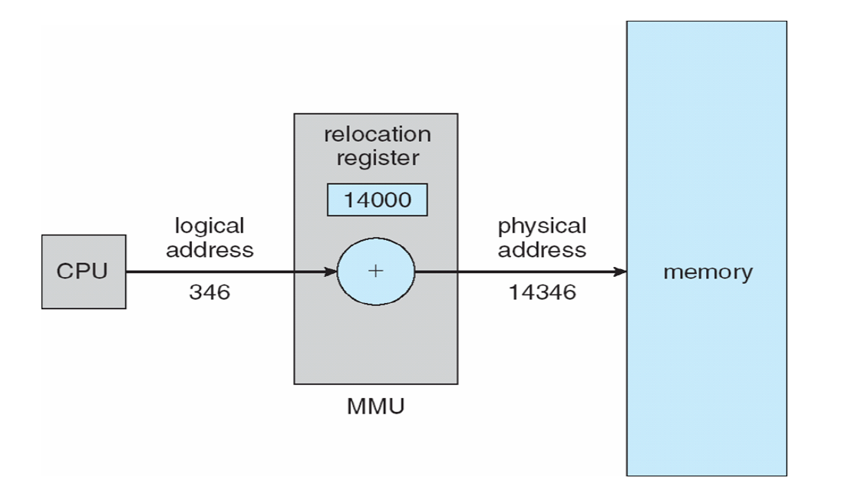
Cont…

Slide 16
Swapping
Swapping is a mechanism in which a process can be swapped temporarily out of main memory to a backing store , and then brought back into memory for continued execution.
Backing store is a usually a hard disk drive or any other secondary storage which fast in access and large enough to accommodate copies of all memory images for all users.
Major time consuming part of swapping is transfer time. Total transfer time is directly proportional to the amount of memory swapped.
Let us assume that the user process is of size 100KB and the backing store is a standard hard disk with transfer rate of 1 MB per second.
The actual transfer of the 100K process to or from memory will take 100KB / 1000KB per second = 1/10 second = 100 milliseconds.

Slide 17
Cont…
Assume a multiprogramming environment with a round robin CPU-scheduling algorithm.
When a quantum expires, the memory manager will start to swap out the process that just finished, and to swap in another process to the memory space that has been freed.
When each process finishes its quantum, it will be swapped with another process.
Idle processes are mostly stored on disk, so they do not take up any memory when they are not running.

Slide 18
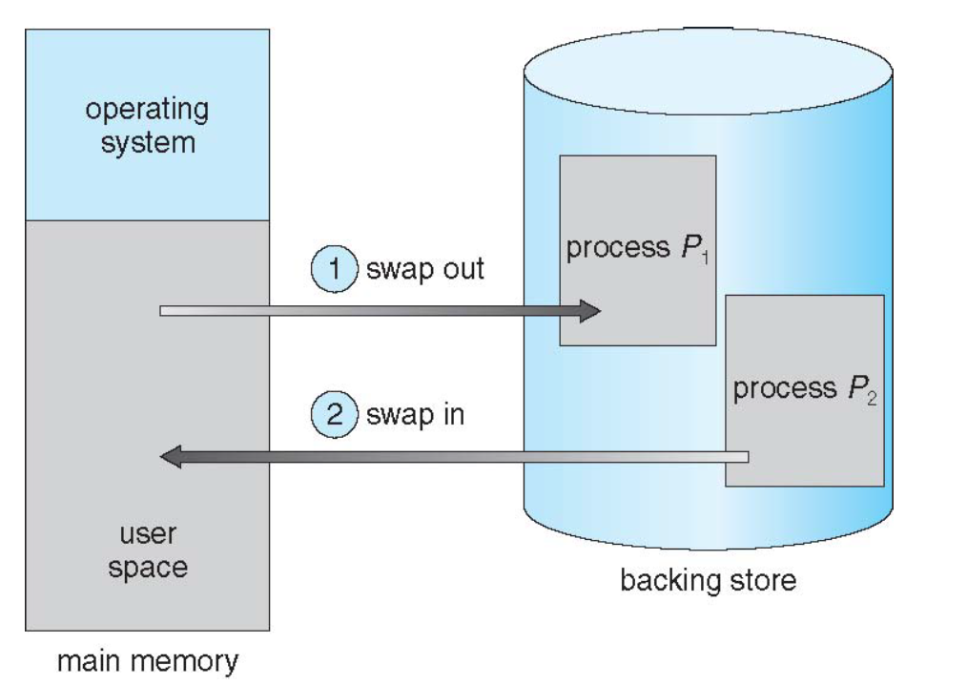
Schematic View of Swapping

Slide 19
Context Switch Time including Swapping
Context Switching involves storing the context or state of a process in PCB so that it can be reloaded when required and execution can be resumed from the same point as earlier.
This is a feature of a multitasking operating system and allows a single CPU to be shared by multiple processes.
Context switch time can then be very high e.g. 100MB process swapping to hard disk with transfer rate of 50MB/sec– Swap out time of 2000 Ms.
– Plus swap in of same sized process
– Total context switch swapping component time of 4000ms (4 seconds)

Slide 20
Memory Allocation
The main memory has to accommodate both the operating system and user space.
That mean main memory is divided into two partitions Low Memory and High Memory.
Low Memory -- Operating system resides in this memory partition.
High Memory --User processes held in this partition. single partition.
Now, here the user space has to accommodate various user processes. We also want these several user processes must reside in the main memory at the same time.

Slide 21
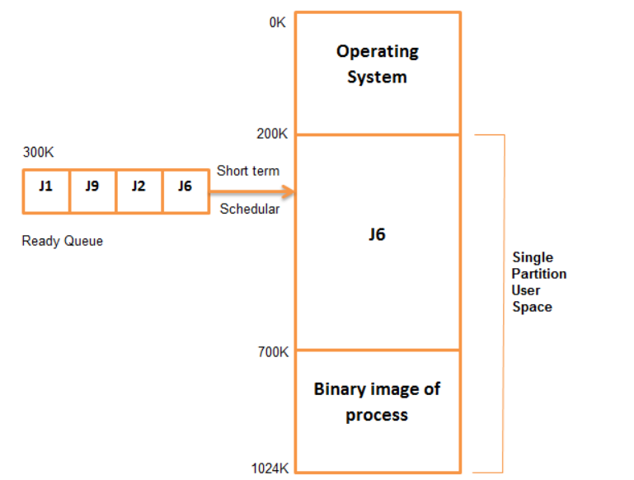
Cont…

Slide 22
Cont…
Although, the question arises how to allocate the available memory space to the user processes that are waiting in a ready queue?
There are two Memory Management Techniques: Contiguous, and Non-Contiguous.
Contiguous memory Allocation
In this memory allocation method, the operating system resides in the low memory.
In Contiguous memory allocation, when the process arrives from the ready queue to the main memory for execution, the contiguous memory blocks are allocated to the process according to its requirement.
In contiguous memory allocation, a process can be stored only in a contiguous fashion.

Slide 23
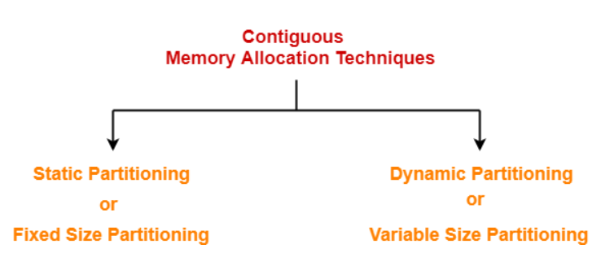
There are two popular techniques used for contiguous memory allocation.

Slide 24
Dynamic/Variable Partitioning
Dynamic partitioning is a variable size partitioning scheme which performs the allocation dynamically.
When a process arrives, a partition of size equal to the size of process is created. Then, that partition is allocated to the process.
This method takes into account the size of the file or a process and also estimates the maximum size, up to what the file or process can grow?
Relocation-register scheme used to protect user processes from each other, and from changing operating-system code and data.

Slide 25
Cont…
Initially RAM is empty and partitions are made during the run-time according to process’s need instead of partitioning during system configure.
The size of partition will be equal to incoming process.
The partition size varies according to the need of the process so that the internal fragmentation can be avoided to ensure efficient utilization of RAM.
Number of partitions in RAM is not fixed and depends on the number of incoming process and Main Memory’s size.
Taking into account the future growth of the file and its request for memory, the operating system allocates sufficient contiguous memory blocks to that file.
Considering this future expansion and the file’s request for memory, the operating system will allocate those many contiguous blocks of memory to that file.
The remaining memory treated as a single partition. This single partition is available for user space. Only one job can be loaded in this user space

Slide 26
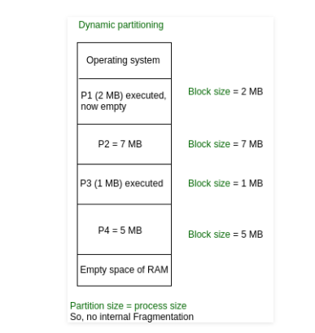
Cont…

Slide 27
Advantages of Variable Partitioning
No Internal Fragmentation: In variable Partitioning, space in main memory is allocated strictly according to the need of process, hence there is no case of internal fragmentation. There will be no unused space left in the partition.
No restriction on Degree of Multiprogramming: More number of processes can be accommodated due to absence of internal fragmentation. A process can be loaded until the memory is empty.
No Limitation on the size of the process: In Fixed partitioning, the process with the size greater than the size of the largest partition could not be loaded and process can not be divided as it is invalid in contiguous allocation technique. Here, In variable partitioning, the process size can’t be restricted since the partition size is decided according to the process size.

Slide 28
Disadvantages of Variable Partitioning
Difficult Implementation: Implementing variable Partitioning is difficult as compared to Fixed Partitioning as it involves allocation of memory during run-time rather than during system configure.
External Fragmentation: There will be external fragmentation in spite of absence of internal fragmentation.
For example, suppose in above example- process P1(2MB) and process P3(1MB) completed their execution.
Hence two spaces are left i.e. 2MB and 1MB. Let’s suppose process P5 of size 3MB comes. The empty space in memory cannot be allocated as no spanning is allowed in contiguous allocation.
The rule says that process must be contiguously present in main memory to get executed. Hence it results in External Fragmentation.

Slide 29
Static/ fixed partitioning
This is the oldest and simplest technique used to put more than one process in the main memory.
In this partitioning, the number of partitions (non-overlapping) in RAM is fixed but the size of each partition may or may not be the same.
As it is a contiguous allocation, hence no spanning is allowed. Here partitions are made before execution or during system configure.

Slide 30
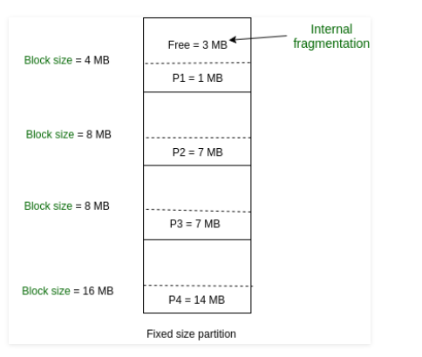
Cont…

Slide 31
Cont…
As illustrated in above figure, first process is only consuming 1MB out of 4MB in the main memory.
Hence, Internal Fragmentation in first block is (4-1) = 3MB.
Sum of Internal Fragmentation in every block = (4-1)+(8-7)+(8-7)+(16-14)= 3+1+1+2 = 7MB.
Suppose process P5 of size 7MB comes. But this process cannot be accommodated in spite of available free space because of contiguous allocation (as spanning is not allowed).
Hence, 7MB becomes part of External Fragmentation.

Slide 32
Advantages of Fixed Partitioning
Easy to implement: Algorithms needed to implement Fixed Partitioning are easy to implement. It simply requires putting a process into a certain partition without focusing on the emergence of Internal and External Fragmentation.
Little OS overhead: Processing of Fixed Partitioning requires lesser excess and indirect computational power.

Slide 33
Disadvantages of Fixed Partitioning
Internal Fragmentation: Main memory use is inefficient. Any program, no matter how small, occupies an entire partition. This can cause internal fragmentation.
External Fragmentation: The total unused space (as stated above) of various partitions cannot be used to load the processes even though there is space available but not in the contiguous form (as spanning is not allowed).
Limit process size: Process of size greater than the size of the partition in Main Memory cannot be accommodated. The partition size cannot be varied according to the size of the incoming process size.
Limitation on Degree of Multiprogramming: Partitions in Main Memory are made during system configure. Main Memory is divided into a fixed number of partitions. Suppose if there are n1 partitions in RAM and n2 are the number of processes, then n2 <= n1 condition must be fulfilled. Number of processes greater than the number of partitions in RAM is invalid in Fixed Partitioning.

Slide 34
Partition Allocation Algorithms/Multiple partition allocation Algorithms
In the above section, we have seen, how the operating system allocates the contiguous memory to the processes.
It is considered better if it avoids internal fragmentation. When it is time to load a process into the main memory and if there is more than one free block of memory of sufficient size then the OS decides which free block to allocate.
Partition allocation algorithms are used to decide which hole should be allocated to the arrived process.
Either static or dynamic :The processes arrive and leave the main memory. As a result, holes of different size are created in the main memory.

Slide 35
Cont…
These holes are allocated to the processes that arrive in future. The question here is that which hole should be allocated to the arrived process?
Memory allocation is done using Round-Robin Sequence. When a process arrives and needs memory, OS search the sets of holes that is large enough for this process.
The Operating system maintains information about free and allocated memory.
To choose a particular partition, a partition allocation method is needed.
When it is time to load a process into the main memory and if there is more than one free block of memory of sufficient size then the OS decides which free block to allocate.

Slide 36
There are different Placement Algorithm:
First Fit
Best Fit
Worst Fit
Next Fit

Slide 37
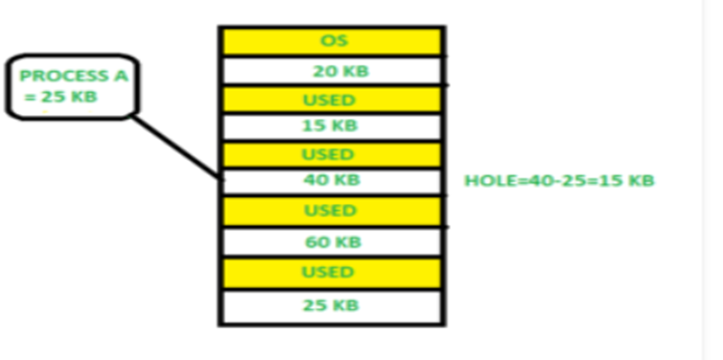
First Fit
In the first fit, the partition is allocated which is the first sufficient block from the top of Main Memory.
It scans memory from the beginning and chooses the first available block that is large enough. Thus it allocates the first hole that is large enough.

Slide 38
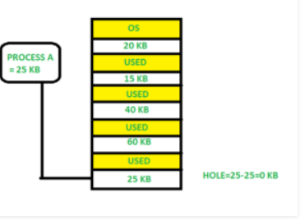
Best Fit
Allocate the process to the partition which is the smallest but, sufficient among the free available partition.
It searches the entire list of holes to find the smallest hole whose size is greater than or equal to the size of the process.
Tries to find a hole which is close to actual process size needed.

Slide 39
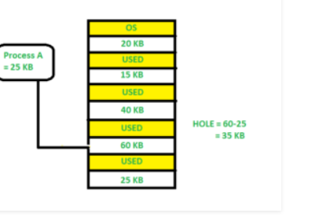
Worst Fit
Allocate the process to the partition which is the largest sufficient among the freely available partitions available in the main memory.
It is opposite to the best-fit algorithm.
It searches the entire list of holes to find the largest hole and allocate it to process.

Slide 40
Next Fit
Next fit is similar to the first fit but it will search for the first sufficient partition from the last allocation point.
Allocate the first hole that fits the from last placement or starts its search wherever it previously stopped searching.

Slide 41
Non-Contiguous Memory Allocation :
Non-Contiguous memory allocation is basically a method on the contrary to contiguous allocation method, allocates the memory space present in different locations to the process as per it’s requirements.
As all the available memory space is in a distributed pattern so the freely available memory space is also scattered here and there.
This technique of memory allocation helps to reduce the wastage of memory, which eventually gives rise to Internal and external fragmentation.

Slide 42
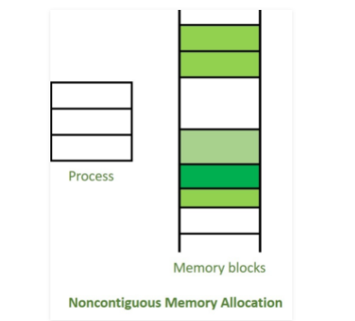
Cont…

Slide 43
Fragmentation
As processes are loaded and removed from memory, the free memory space is broken into little pieces.
It happens after sometimes that processes cannot be allocated to memory blocks considering their small size and memory blocks remains unused.
This unused block is called Fragmentation.
Fragmentation cause waste of memory and a compaction technique can be used to create more free memory out of fragmented memory:

Slide 44
Two types of fragmentation
Internal:-Memory block assigned to process is bigger. Some portion of memory is left unused as it can not be used by another process.
External:-Total memory space is enough to satisfy a request or to reside a process in it, but it is not contiguous so it can not be used.
Dynamic partition is possible when OS combine contiguous internal fragmentation and make enough for other process accommodation that leads to reduce internal fragmentation. Which is called compaction technique.

Slide 45
paging
In computer operating systems, memory paging is a memory management scheme by which a computer stores and retrieves data from secondary storage for use in main memory.
Paging is a memory management technique in which process address space is broken into blocks of the same size called page and the size of the process is measured in the number of pages.
In this scheme, the operating system retrieves data from secondary storage in same-size blocks called pages.
Similarly main memory is divided into small fixed-sized blocks of (physical) memory called frames and the size of a frame is kept the same as that of a page.

Slide 46
Cont…
Paging technique plays an important role in implementing virtual memory.
Suppose you have a program of 8Kb but your memory can accommodate only 5Kb at a given point in time, then the paging concept will come into picture.
When a computer runs out of RAM, the operating system (OS) will move idle or unwanted pages of memory to secondary memory to free up RAM for other processes and brings them back when needed by the program by using page information.
Paging reduces external fragmentation, but still suffer from internal fragmentation.

Slide 47
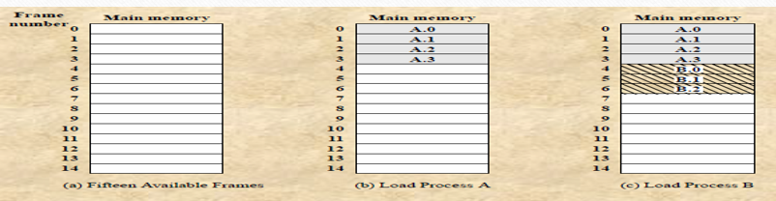
Pages vs Frames

Slide 48
Process Page Table
A page table is the data structure used by a virtual memory system in a computer operating system to store the mapping between virtual addresses and physical addresses.
Data structure is a data organization, management, and storage format that enables efficient access and modification.
So, A page table stores the definition of each page. When an active process requests data, the MMU retrieves corresponding pages into frames located in physical memory for faster processing.
The page table is where the operating system stores its mappings of virtual addresses to physical addresses.
Therefore, process page table Contains the frame location for each page in the process.

Slide 49
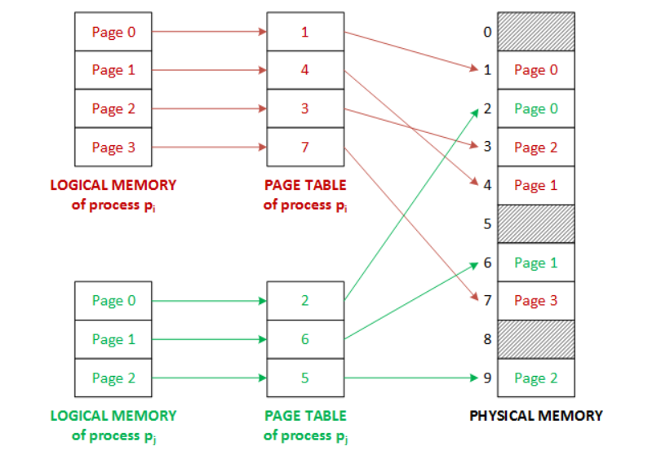
Cont…

Slide 50
Address Translation Scheme
When the system allocates a frame to any page, it translates this logical address into a physical address and create entry into the page table to be used throughout execution of the program.
When a process is to be executed, its corresponding pages are loaded into any available memory frames.
Address generated by CPU is divided into:
Page number (p) – used as an index into a page table and contains base address of each page in physical memory.
Page offset (d) – combined with base address to define the physical memory address that is sent to the memory.
Logical Address = Page number + page offset
Physical Address = Frame number + page offset

Slide 51
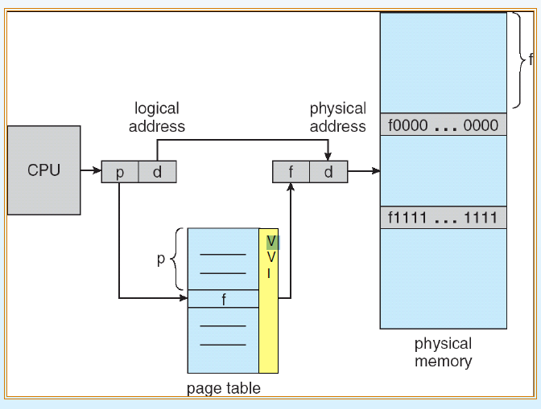
Address Translation Architecture!

Slide 52
Segmentation
Segmentation is a technique to break memory into logical pieces where each piece represents a group of related information and has its own base address.
Also, each job is divided into several segments of different sizes, one for each module that contains pieces that perform related functions. Each segment is actually a different logical address space of the program.
It is basically used to enhance the speed of execution of the computer system, so that the processor is able to fetch and execute the data from the memory easily and fast.
When a process is to be executed, its corresponding segmentation are loaded into non-contiguous memory though every segment is loaded into a contiguous block of available memory.
Segmentation memory management works very similar to paging but here segments are of variable-length where as in paging pages are of fixed size.

Slide 53
Cont…
The operating system maintains a segment map table for every process and a list of free memory blocks along with segment numbers, their size and corresponding memory locations in main memory.
For each segment, the table stores the starting address of the segment and the length of the segment.
A reference to a memory location includes a value that identifies a segment and an offset.

Slide 54
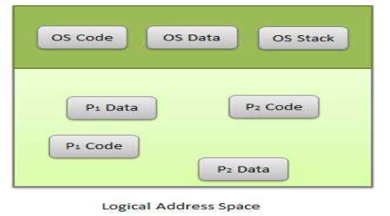
Cont…

Slide 55
Demand Paging
It is a method of virtual memory management. In a system that uses demand paging, the operating system copies a disk page into physical memory only if an attempt is made to access it and that page is not already in memory.
When a process is to be swapped in, the OS guesses which pages will be used before the process is swapped instead of swapping in a whole process, the OS brings only those necessary pages into memory.
Thus, it avoids reading into memory pages that will not be used in anyway, decreasing the swap time and the amount of physical memory needed.

Slide 56
VIRTUAL MEMORY
Virtual memory is a section of volatile memory created temporarily on the storage drive. It is created when a computer is running many processes at once and RAM is running low.
The operating system makes part of the storage drive available to use as RAM. Virtual memory is much slower than main memory because processing power is being taken up by moving data around, rather than just executing instructions.
The main visible advantage of this scheme is that programs can be larger than physical memory.

Slide 57
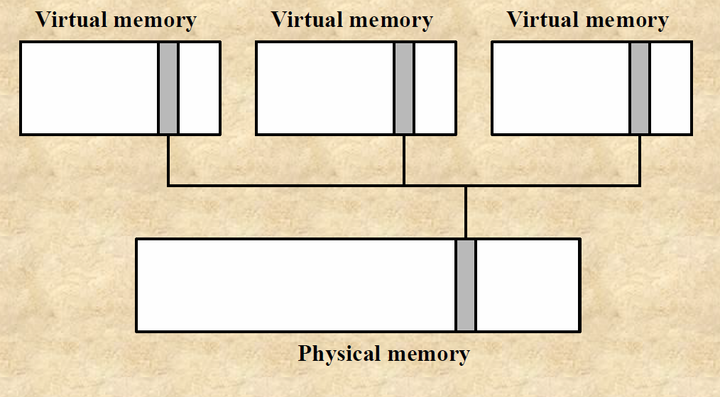
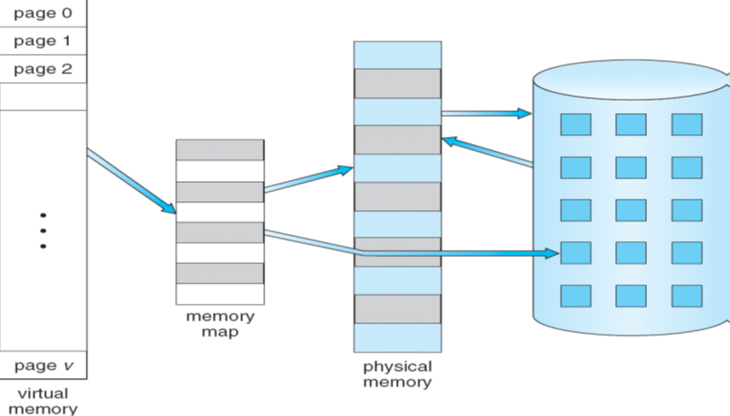
Cont…

Slide 58



Question
~~~~~~~~~~~~THE END~~~~~~~~~~~~~
`````````````````IF QUESTION?``````````````````

